Slide 1
My Family and My Roots
A 9th Grade Family History Film Project
Lowell Blackman
Atid Lod High School of Sciences
Lod, Israel
CJN KRAKÓW, OCT 29-31, 2017

Slide 2
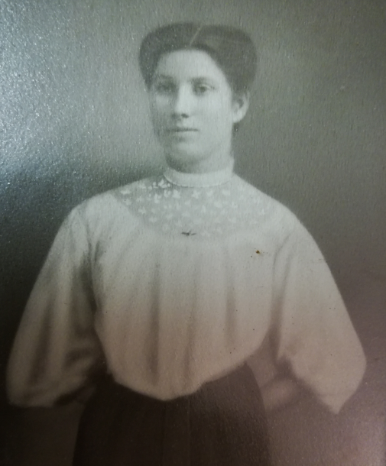
Ida Raymond, who came to the United States from Odessa, Ukraine, alone, at age 15
My maternal grandmother

Slide 3
INTRODUCTION TO CENTROPA
http://www.centropa.org
http://www.centropa.org/centropa-cinema/10-years-4-minutes?subtitle_language=
http://www.centropa.org/centropa-cinema/introduction?subtitle_language=

Slide 4
Introduction
Primary subject of lesson: English (History, Civics, Jewish Studies)
Grade level of students: 9th Grade English Class
Assignment: My Family and My Roots: A 9th Grade Family History Film Project
Goal: To create a historical, biographical digital film (modeled after Centropa biographical films)
Focus of project:
Story of the life of an older family member
Story of the family over the course of several generations

Slide 5
Objectives and Educational Goals (1)
English Language Arts
to write a film script that demonstrates competence in general writing skills
to edit and rewrite script for final narration
to include subtitles in the film; proofreading, spell-checking, and grammar-checking are essential
to gather and select historical information, images, documents from family
to engage in historical research
to select historical information from research

Slide 6
Objectives and Educational Goals (2)
Historical Competency
to understand the sequence of a timeline
to focus on events AND
to understand significance of events in the life of the person they chose to write about
to understand how events in the world, nation, city, or community impacted their lives
to foster competence in GEOGRAPHY - that is …
to understand where the story “took place”
to pay attention to geography and maps selected – especially historical maps

Slide 7
Objectives and Educational Goals (3)
Social and Moral Dimensions
To connect to one’s family via the interview process
To tell a personal story of a someone close to them
To imagine the day-to-day lives that people lived before, during, and after WW I and prior to WW II
To attempt to understand how people’s lives looked “so long ago”
To try and understand decisions made in the life / lives of (a) family member(s)
To empathize with people and to feel the human spirit
To attempt to understand what people had to go through in their lives

Slide 8
Objectives and Educational Goals (4)
Technological skills
to gather and select images, documents, music that go well with the script
to learn to use a film-making program (Movie Maker, Sony Vegas, etc.)

Slide 9
Objectives and Educational Goals (5)
Interdisciplinary Aspects and Considerations
Music for the film: selecting music in the background that reflects the sensitivities of the film and the subject
9th grade history curriculum covers 19th and 20th Century European nationalism, the birth of Zionism, and World War I and its aftermath; (Roots Project fits well into this time frame and context.)

Slide 10
Procedure (1)
Post the Student Guide on school website / class e-mail (The Teacher’s Guide, an annotated version of the Student’s Guide, is also available.)
Students read and review project at home
Review goals and student procedures together in class

Slide 11
TIPS ON THE CENTROPA WEBSITE
http://www.centropa.org/sites/default/files/analyzing_a_centropa_film.pdf
Making it True, Making us Care:
Understanding What Makes a Story Compelling
-
Teacher’s Instructions
-
Student Worksheet: Viewing Films

Slide 12
The Student Project Guide for Creating Roots and Family Films can be found on the Centropa website:
http://www.centropa.org/teaching-materials
Click on EDUCATION
The updated 2017 version of the guide is available.
../../PPT PRESENTATIONS/00 2017 KRK Student Project Guide - Creating Family History Films Using Centropa and Other Sources.docx

Slide 13
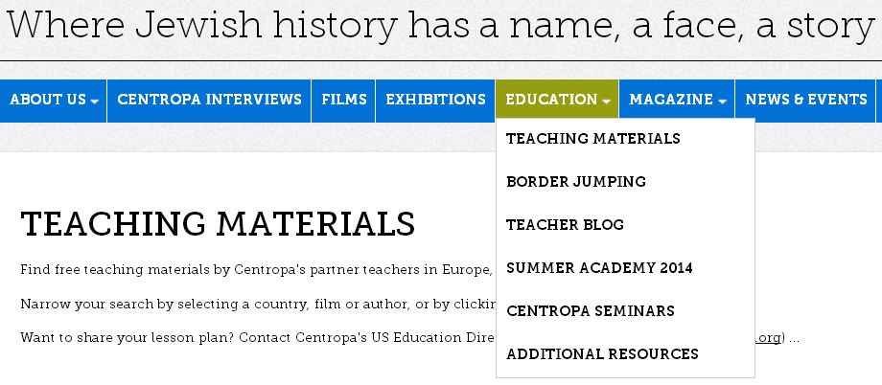
The drop-down menu provides you with several options.
Click on TEACHING MATERIALS

Slide 14
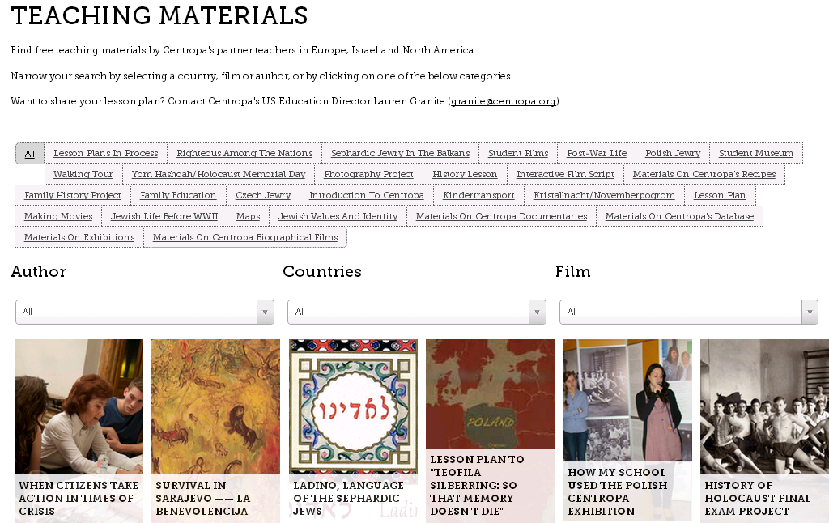
Scroll down the page

Slide 15
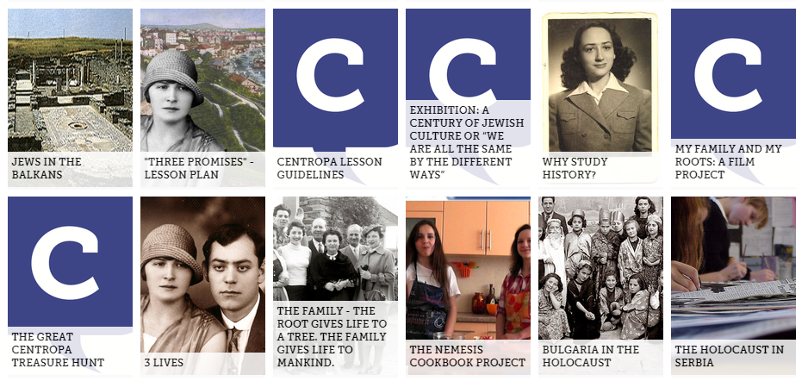
Roots Film Project Guide
Click on the picture.

Slide 16
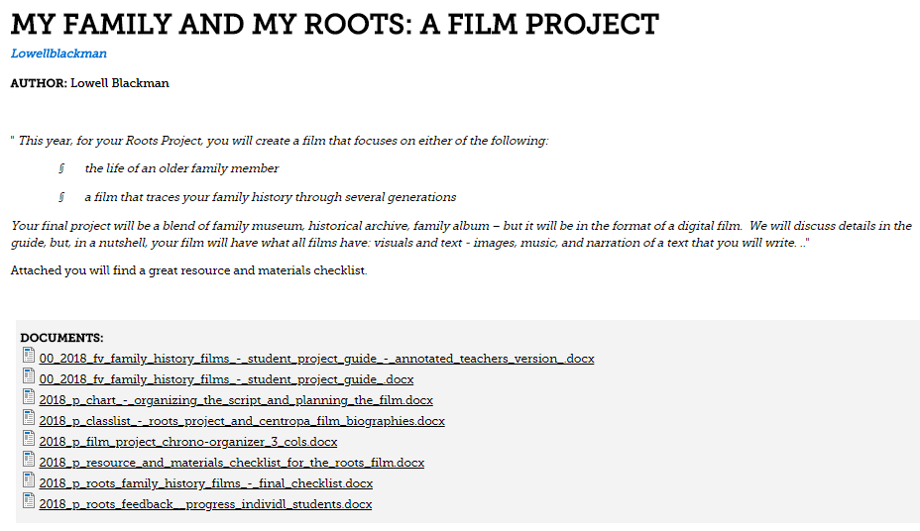
The screen below appears, introducing you to the Roots Family History Film Project.

Slide 17
The list of documents below will help both you and your students throughout the course of the filmmaking project.
There is a Student Guide, a Teacher’s Guide (Student Guide with Annotations for Teachers), a variety of organizer charts, scriptwriting and planning charts, checklists, feedback during the filmmaking process, etc.
Have a look!

Slide 18
Procedure (2)
The Great Centropa Treasure Hunt
Exploring and Navigating the Centropa Website

Slide 19
The Great Centropa Treasure Hunt
Exploring and Navigating the Centropa Website
The treasure hunt helps students become familiar with the Centropa website.
Questions have been designed to take them to most parts of the website.
This is especially helpful as they will often refer to the website to model their own films.

Slide 20
The Great Centropa Treasure Hunt

Slide 21
This treasure hunt allows students to become familiar with the Centropa website as the questions have been designed to take them to most parts of the website. This is especially helpful as they will often refer to the website to model their own films. The illustration above is a sample from the worksheet.
..\..\00 2018 THE GREAT Centropa TREASURE HUNT.docx

Slide 22
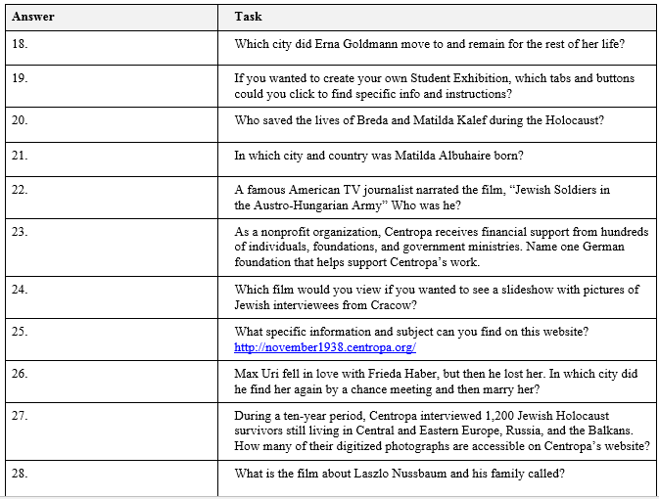
SAMPLE PAGE

Slide 23
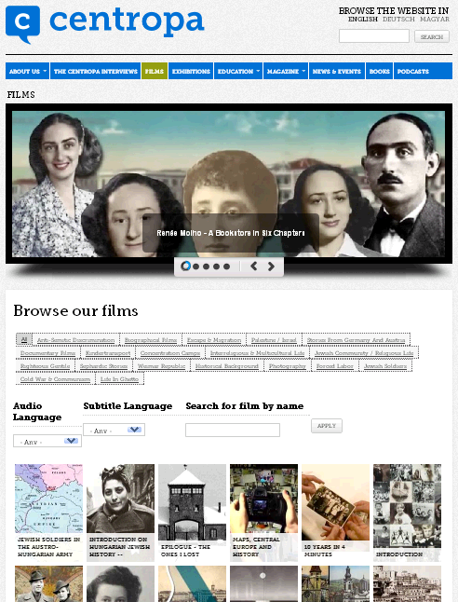
More Practical Information: Navigating the Centropa Website

Slide 24
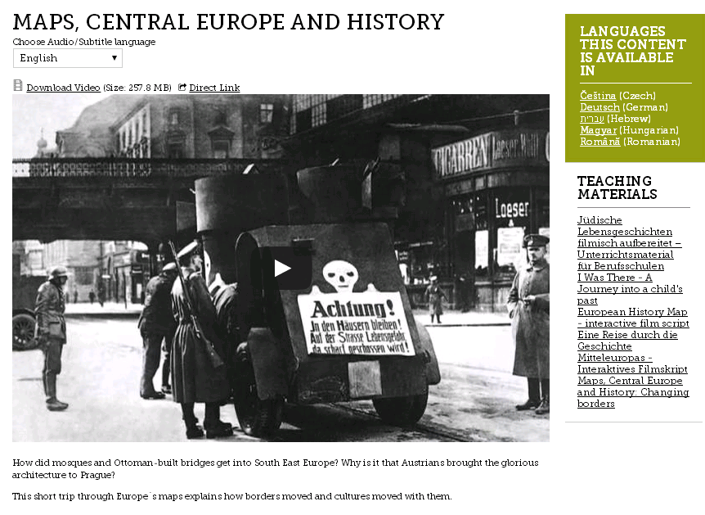
Choosing Languages

Slide 25
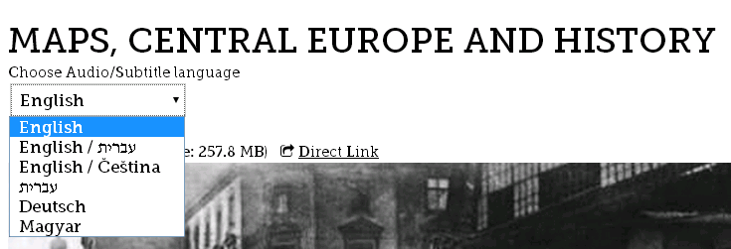
Choosing Languages:
Audio and Subtitles

Slide 26
Viewing Centropa Films
To become familiar with how
a film biography is written
a biography depicted in film
a film biography is narrated
visuals, images, and movement are used
music enhances the story and mood
sound effects add “color”
we come to know a person more “closely”

Slide 27
Sharing Centropa Films 1

Slide 28
Sharing Centropa Films 1
Leo Luster
“The Past is Another Country”
Sharing Centropa Films 1
..\..\LEO LUSTER\Leo Luster Comprehensive Questions FV1.docx

Slide 29
Sharing Centropa Films 2

Slide 30
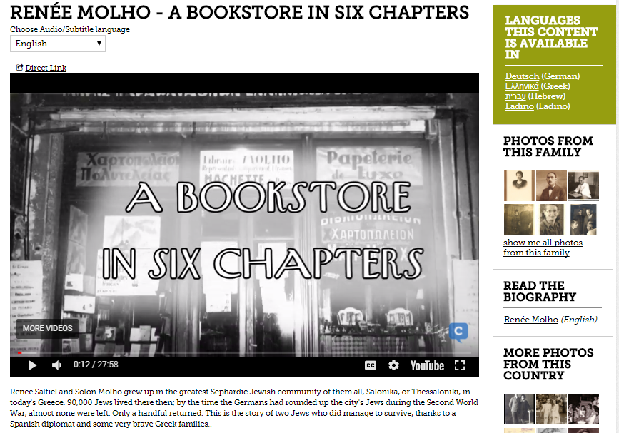
Sharing Centropa Films 3

Slide 31
Sharing Centropa Films 4
Thinking About the Look and Feel of the Film
The Cinematography of Roots and Family History Films
Using Renée Molho’s Film, “A Bookstore In Six Chapters”
..\Viewing Centropa Films to create own 2016 A Bookstore in Six Chapters.docx

Slide 32
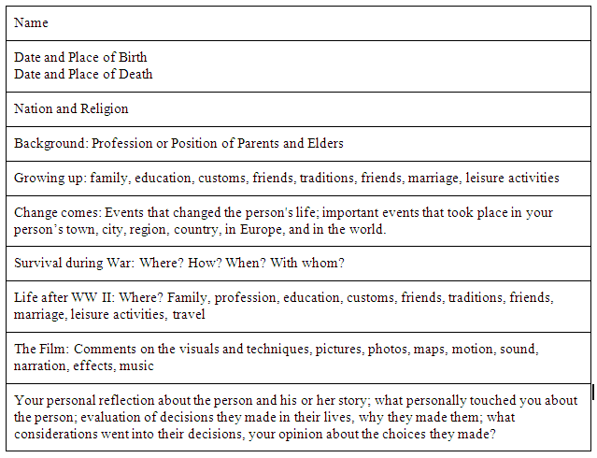
Viewing Centropa Films
Learning about one person’s life
(sample page – original doc linked below)
..\2018 centropa person profile + q's chart every name.docx
SAMPLE PAGE

Slide 33
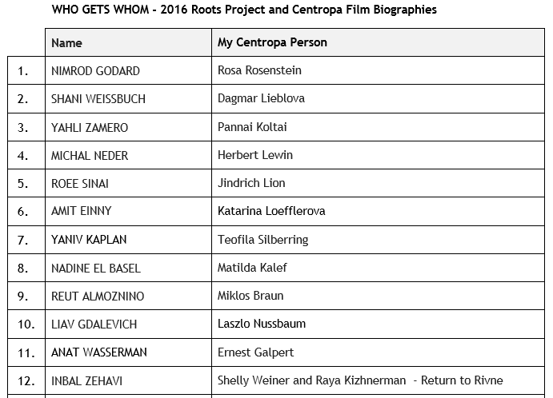
..\2018 STUDENT GUIDE FINAL DOCS\FINAL FINAL DOCS TO SEND\2018 WHO GETS WHOM - 2016 Roots Project - Centropa Film Biographies - Classlist.docx
SAMPLE PAGE

Slide 34
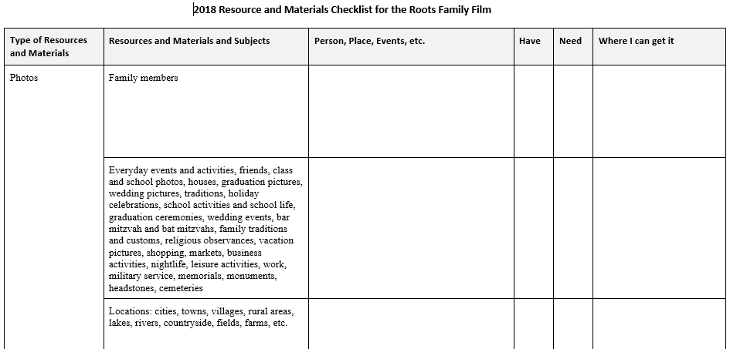
Procedure (3) Locating and Gathering Information
..\2018 STUDENT GUIDE FINAL DOCS\2018 P Resource and Materials Checklist for the Roots Film.docx
SAMPLE PAGE

Slide 35
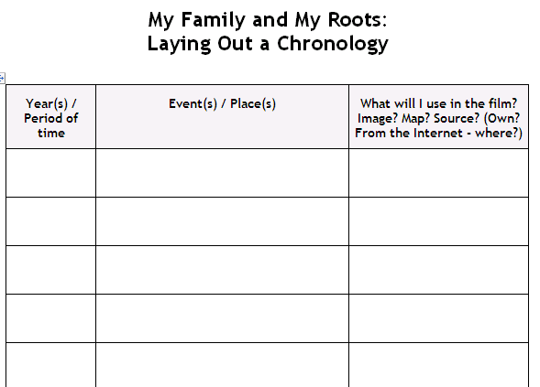
Procedure (4) Getting Started on the Script
SAMPLE PAGE
..\2018 STUDENT GUIDE FINAL DOCS\2018 P Film Project Chrono-Organizer 3 cols.docx

Slide 36
Procedure (5.1) Organizing the Script and Planning the Film
..\2018 STUDENT GUIDE FINAL DOCS\2018 P Chart - Organizing the Script and Planning the Film.docx
The chart shown in the following slide is a sample portion of the chart designed to help you coordinate your script with images (e.g., images, maps), audio features (music, sound effects, narration) that you'll insert in your film.
When pictures appear on screen
How long they remain on screen
What you do with them – fade in, fade out, zoom in, zoom out, move
When they change, when other pictures (and maps) appear
Subtitles that are synchronized to the narration
When there are pauses in the narration
When we hear music, type of music – fade in, fade out, etc.

Slide 37
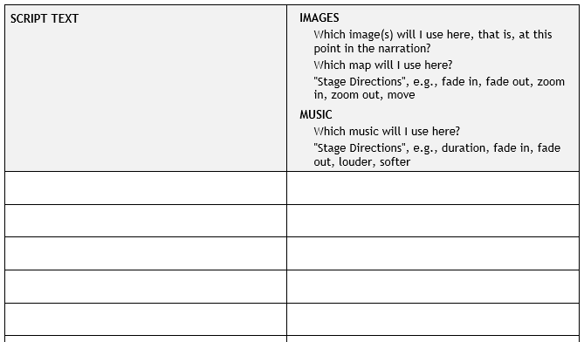
Procedure (5.2) Organizing the Script and Planning the Film
Access the full chart using this link:
..\2018 STUDENT GUIDE FINAL DOCS\2018 P Chart - Organizing the Script and Planning the Film.docx
SAMPLE PAGE

Slide 38
Procedure (6)
Computer lab time for research, reviewing, editing, rewriting scripts
After a “chunk of time” passes, during which time kids have worked at home, schedule a computer room session to
answer questions
try and solve problems; peer and group help
make suggestions
help with script
check general progress
Touching Base: ”Work in Progress” Questionnaire

Slide 39
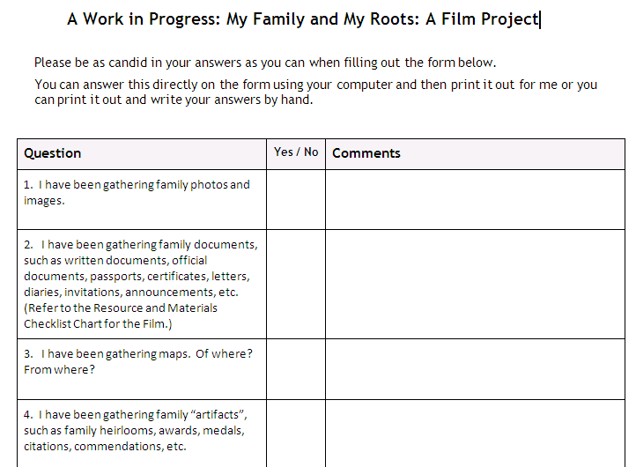
..\2018 STUDENT GUIDE FINAL DOCS\FINAL FINAL DOCS TO SEND\2018 PS ROOTS Feedback + Progress individ'l students.docx
SAMPLE PAGE

Slide 40
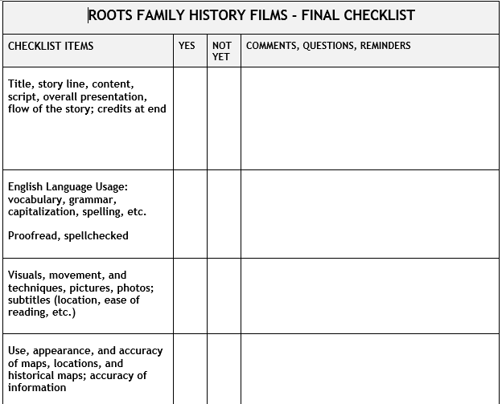
Procedure (7.1)
Follow-up Documents and Charts
..\2018 P FINAL SELF-CHECKLIST.docx
SAMPLE PAGE

Slide 41
Procedure (7.2)
Follow-up Documents and Charts
Teacher’s Grading Rubric
..\2018 9 AE ROOTS Grades chart 2016.docx

Slide 42
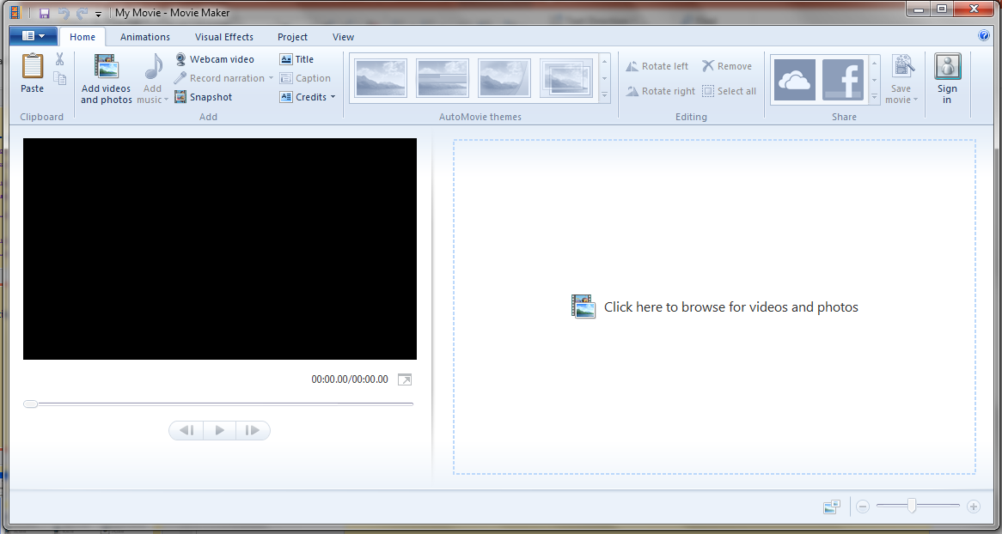
Procedure (8)
Getting Started on the Film
Microsoft Movie Maker

Slide 43
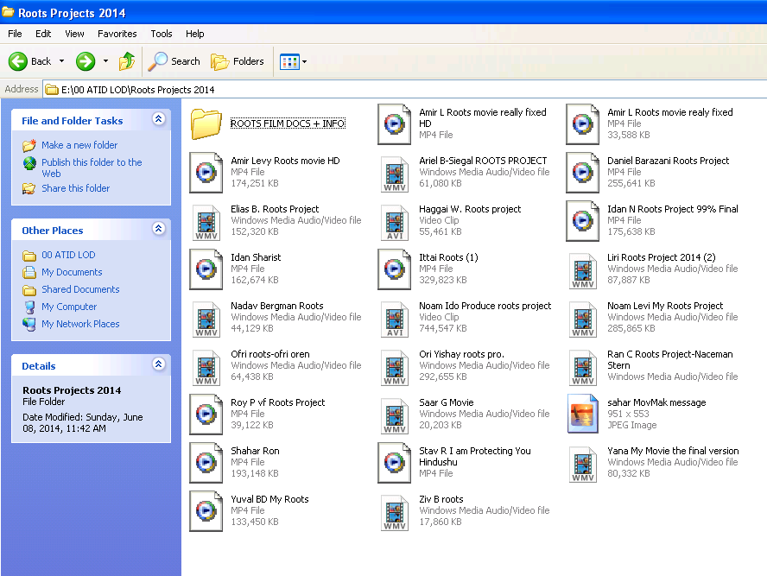
Collection of Student Roots Films 2014 Formats: YouTube, MP4, Windows Media Audio/Video File

Slide 44
Selection of Student Roots Films
on YouTube
2014 – 2016
..\..\..\2014-2017 ROOTS FINAL YouTube LINKS 10-2017.docx

Slide 45
Selected Roots Films 9th Grade 2016
Yahli Zamero
https://youtu.be/wtXsGmHXcYc
https://www.youtube.com/watch?v=wtXsGmHXcYc&feature=youtu.be
Michal Neder
https://www.youtube.com/watch?v=aD2ggj3S2SY
Inbal Zehavi
https://drive.google.com/file/d/0B2DwvFQunMZBM0RpbW8tVnBlb2M/view?usp=drivesdk
Anat Wasserman 9:09 (Krakow)
https://drive.google.com/file/d/0B_DCiHy0L2JiY3FUTWFTdktjZ1E/view?ts=59ef1a68

Slide 46
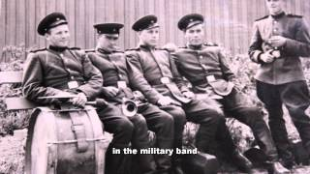
https://www.youtube.com/watch?v=dh85MIpk_S8
Guy Podolich (9th Grade 2013-2014)
Preview YouTube video English Roots project

Slide 47
Selected Roots Films
9th Grade 2014
Stav Ronen “I Am Protecting You, Hindushu” 15:20 (A Film Beginning in Krakow)
https://www.youtube.com/watch?v=q-5Q_DogiAw
On the left of settings in the bottom right corner there is a button labeled "captions". Just click on it and then choose "English" (NOT automatic English!), then choose "on" and that will activate the subtitles.
Itamar Green 13:26
http://youtu.be/GOM-At790RA

Slide 48
Selected Roots Films 9th Grade 2015
Amir Golan https://youtu.be/RbaJrvt7Mqc
Ido Nachlieli https://www.youtube.com/watch?v=Nxa414iTqso

Slide 49
CENTROPA and POST-ROOTS ACTIVITIES (1)
The Family History Project lends itself to a number of related, follow-up projects, activities, and research using the Centropa website and Centropa films both as a source and starting point.
In addition to their basic content and biographical stories, many Centropa films cover a wide range of subjects and themes.

Slide 50
CENTROPA and POST-ROOTS ACTIVITIES (2)
Centropa films can be used to spark investigating related topics, follow-up issues, and questions that arise from the Roots Project.
The films can lead students to explore and research associated ideas, topics, subjects, and themes.
Some of these related topics and themes are available in other documents and lesson plans on the Centropa website.

Slide 51
POST-ROOTS ACTIVITIES (3)
Post-Roots Family History Project topics and themes will be available on the Centropa website in the near future.
You’ll find them in the as projects, activities, lesson ideas, lesson plans. Here’s a sample:
The Righteous Among the Nations (Centropa Films)
Kindertransport Project
“Every Name has a Face, Every Face has a Story ”
Languages and Names
Maps and Change - “Maps, Central Europe, and History”
Citizenship, Nationality, and Identity …. Who Am I?
“My Story, Their Story, and the World” Parallel Timelines
Parallel Lines, Parallel Lives …. And Far Away
Border Jumping and Projects With Other Schools

Slide 52
The End
of this Presentation …
The Beginning
of Yours

