Slide 1
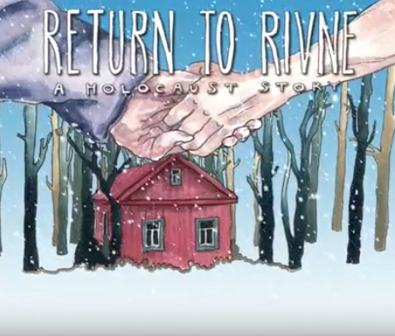
A Holocaust Story
Shelly
Raya
Before
After

Slide 2
Think Pair Share
Using your prior knowledge of the history of Central Europe, how have borders impacted the life of everyday people?
Notes:
“Maps, Central Europe, and History” has already been viewed by my students

Slide 3
Everybody knows that…
What information do you think is probably common knowledge about the Holocaust?

Slide 4
Return to Rivne
Key People
Shelly and her mother
Raya and her mother
Shelly and Raya’s mothers are sisters
Key Places
Rivne
Miatyn
Poland
Ukraine
Leningrad/St. Petersburg

Slide 5
Return to Rivne
Removed the imbedded film so that it could be emailed.

Slide 6
Discussing your question
Build a group of no more than 5 people.
Identify one person who will serve as a reporter to share out the key points that your group discussed in answering your question.
Using your notes, conduct a small group discussion with your classmates that sequences through all four parts of the film going in order. Every group member is expected to actively participate in the discussion.
Collectively agree on what you want your reporter to share with the class. Keep in mind that other groups were not focusing on the same questions.

Slide 7
Share Out

Slide 8
Digging Deeper
What do you think is the personal and communal value of “revisiting” the locations and experiences of traumatic events in history? Explain.
What do you think is the biggest lesson that students your age can learn from the experiences of Shelly and Raya? Explain.
How did Shelly and Raya’s story deepen your understanding of the complexity of the Holocaust beyond your prior knowledge and experience with the topic?

