Slide 2
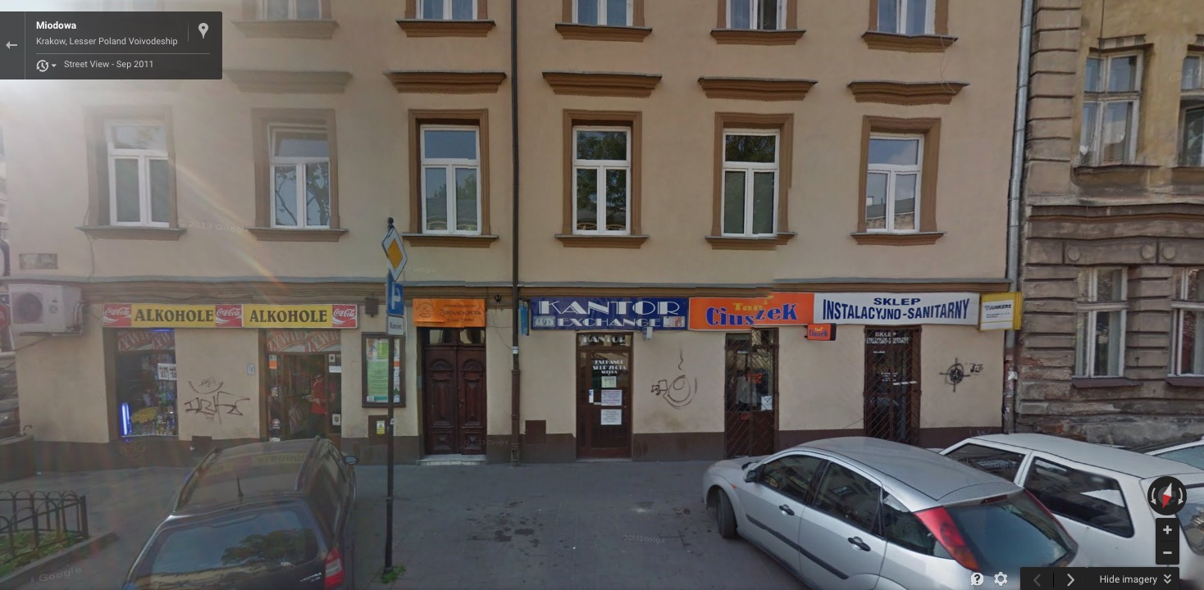
Section 2 / Map A - Miodowa 21 (google maps link)

Slide 3
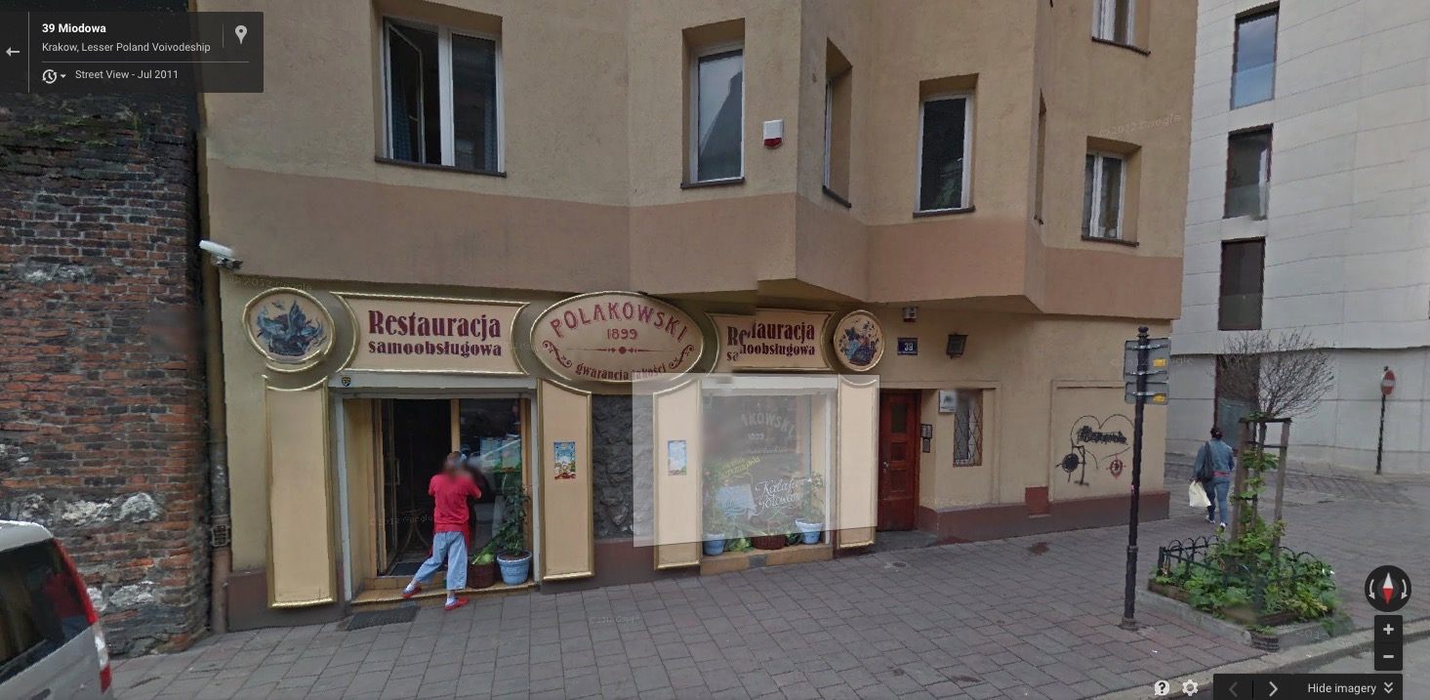
Section 2 / Map B - Miodowa 39 (google maps link)

Slide 4
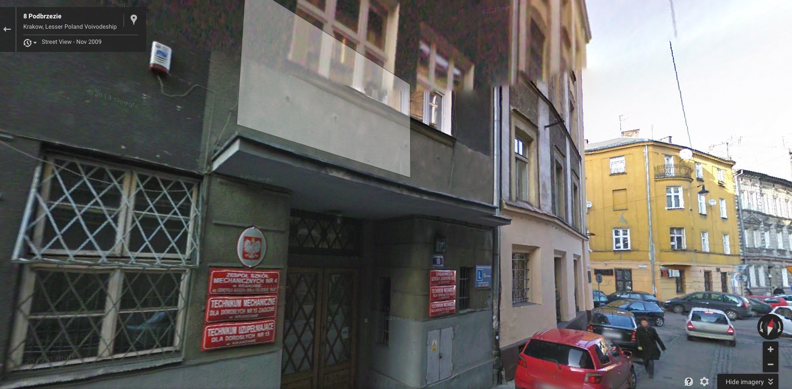
Section 2 / Map C - Hilfstein Hebrew Gymnasium
(google maps link)

Slide 5
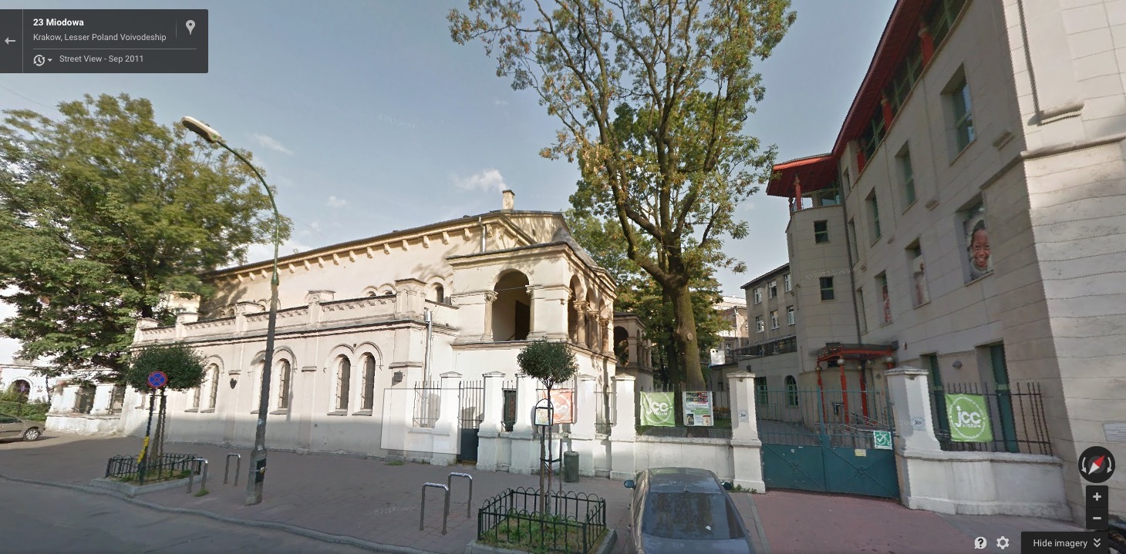
Section 2 / Map D - Temple, Miodowa 24
(google maps link)

Slide 6
Section 3 / Map A - Miodowa 21 (google maps link)

Slide 7
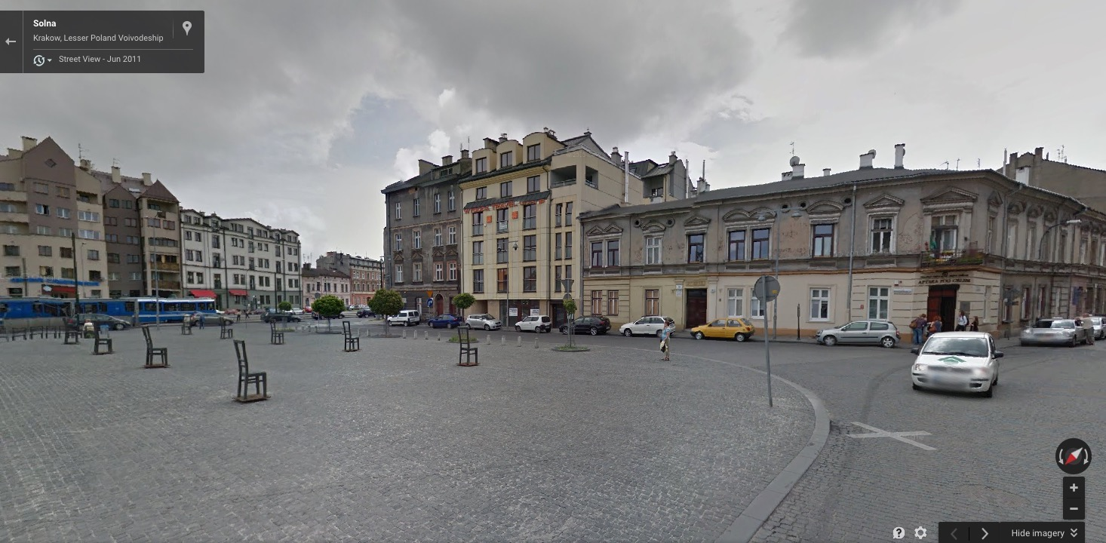
Section 3 / Map E - Ghetto Heroes Square
(google maps link)

Slide 8
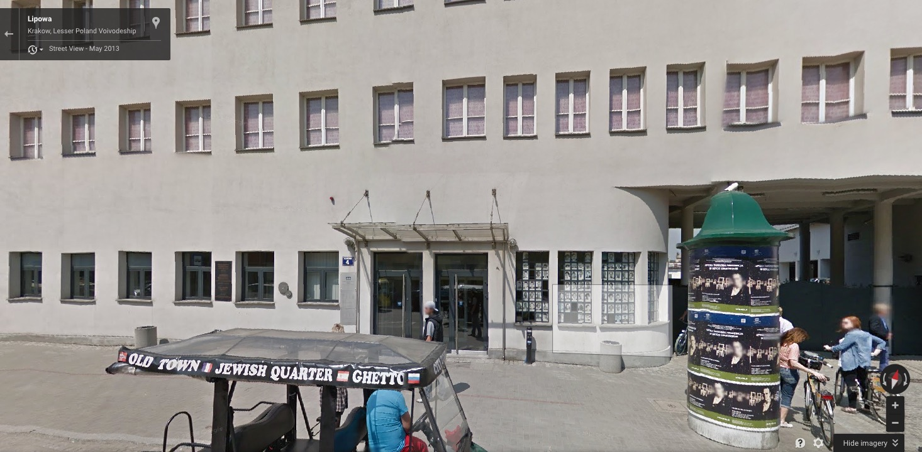
Section 3 / Map F - Schindler (Lipowa 4)
(google maps link)

Slide 9
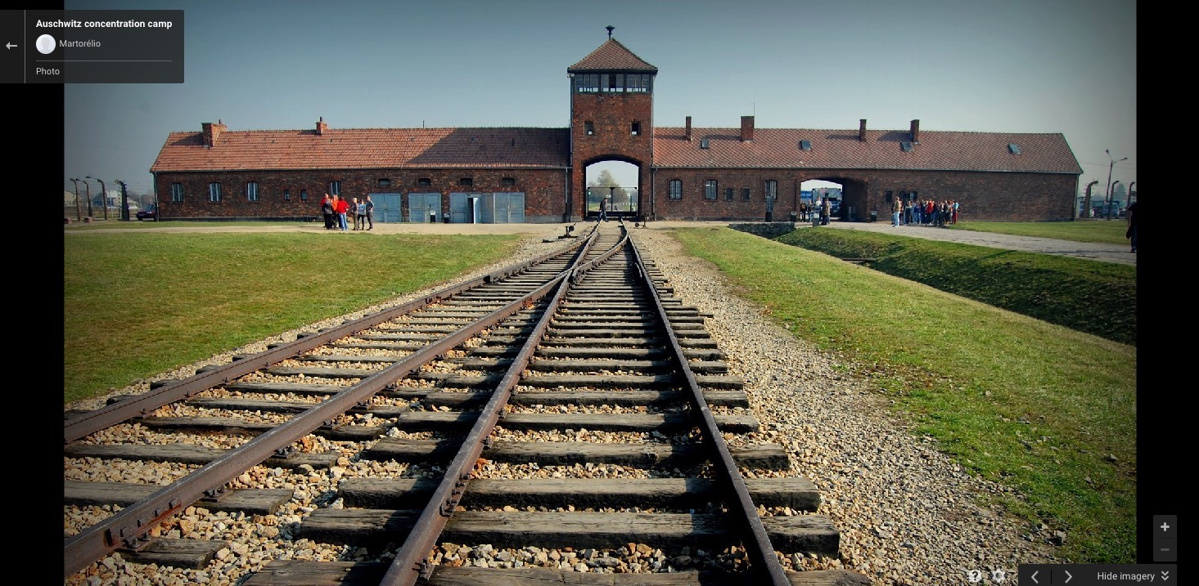
Section 3 / Auschwitz Concentration Camp
(google maps link)

Slide 10
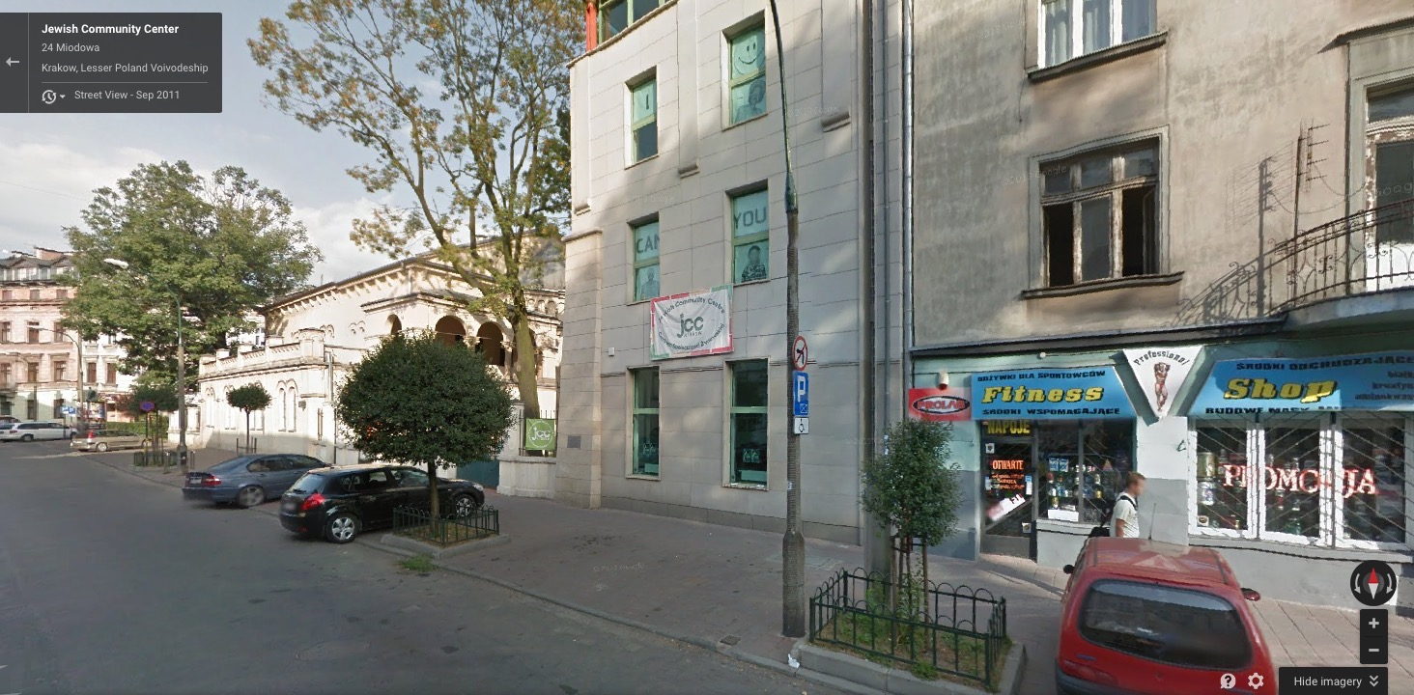
Section 4 / Life After The War
(google maps link)

